Slide 1
Data Structures and Algorithms IICT-6005
Lesson 4 – Empirical Analysis

Slide 2
Lesson Content
Empirical analysis through benchmarks
Benchmarking and it’s weaknesses
Plotting benchmarks and log-log graphs
Benchmark visual inspection
Analysis of parallel lines in log-log graphs

Slide 3
Empirical Analysis
Empirical Analysis refers to knowledge gained through direct practical experience rather than through logic or scientific proof.
Empirical Analysis of Algorithms can be carried out using Posterior Analysis and Benchmarking as a technique.
This involves :
Implementing the selected algorithm using a programming language.
Executing the code on a target computer machine for different sizes of the problem.
Taking note of actual statistics like running time and space required
Analyzing the actual statistics to determine the efficiency of the algorithm, possibly using Log-Log Graphs.

Slide 4
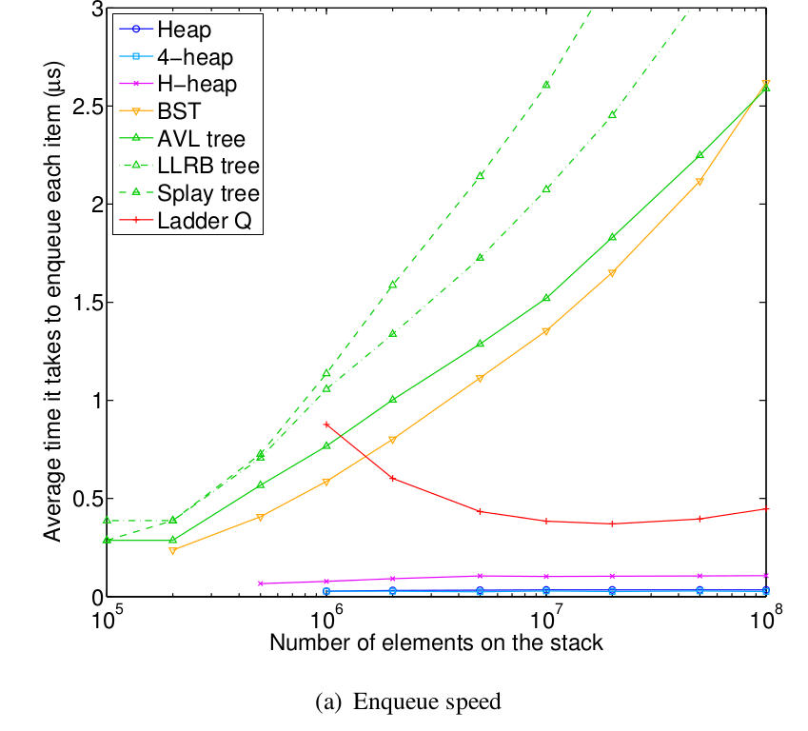
Empirical Analysis
The following graph was obtained by observing how much time an Enque() operation takes for queue of various sizes implemented using different data structures.
The amount of nano-seconds taken by each data structure to Enque each set of elements was plotted.
This allows for different techniques to be compared side by side.
Note how for larger problem sizes, the computation takes more time.

Slide 5
Empirical Analysis
Empirical Analysis is easy to carry out and allows for good comparisons of different algorithms or data structures in order to determine the most efficient option.
But….
The results depend on the implementation and environment
a poor implementation will lead to poor results
the hardware used will affect the results
background results may affect performance;
Conclusions are based only on the observations and not on the true efficiency of the algorithm or data structure.

Slide 6
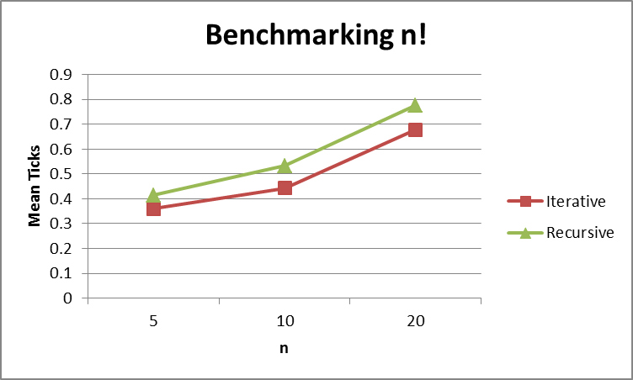
Sample Results
Assume that calculating the Factorial Result of n numbers was calculated using 2 different ways:
Iteratively using Loops
Recursively
The following are a sample set of results obtained when both algorithms were executed to calculate the factorial value of 5, 10 and 20 numbers.
Notice how the time (here in ticks) grows as the problem size (n) grows.
n | Iterative | Recursive
5 | 0.36 | 0.414
10 | 0.443 | 0.532
20 | 0.678 | 0.777

Slide 7
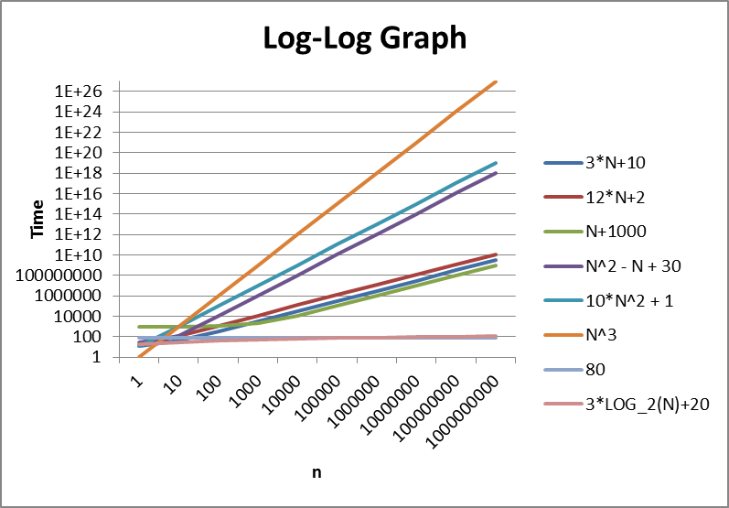
Log-Log Graphs

Slide 8
Log-Log Graphs
The results of Bench Marking are often used to create Log-Log Graphs to make it easier to analyze how long a particular computation takes for an input of size n.
The time taken is plotted on the Y-Axis whilst the size of the problem (n) is plotted on the X-axis.
Plotting time taken vs problem size for different algorithms/data structures allow for a visual side by side comparison to determine the best option.
How?
By taking note of the gradient of the graph!
The higher the gradient of a graph, the steeper the graph is.
This means that as the size of the problem increases, time also increases at a higher rate.

Slide 9
Log-Log Graphs
The results of Bench Marking are often used to create Log-Log Graphs to make it easier to analyze how long a particular computation takes for an input of size n.
The time taken is plotted on the Y-Axis whilst the size of the problem (n) is plotted on the X-axis.
Plotting time taken vs problem size for different algorithms/data structures allow for a visual side by side comparison to determine the best option.
How?
By taking note of the gradient/slope of the graph!
The higher the gradient or the steeper the graph is, the less efficient the algorithm or data structure is.
The lower the gradient or the flatter the graph, the more efficient the algorithm or data structure is is.

Slide 10
Log-Log Graphs
Why?
A steeper graph (or higher gradient) means that as the size of the problem increases, so does the rate at which the time taken to complete the operations but this is happening at an increasing rate.
A small change in X (size) has lead to a large change in Y (time), therefore meaning that if the size of the problem is increased even just a little bit, time could increase drastically.
The opposite applies for flatter graphs as for increases in the size of the problem (n) only small increases in time are noted.
Gradient = Change in Y / Change in X

Slide 11
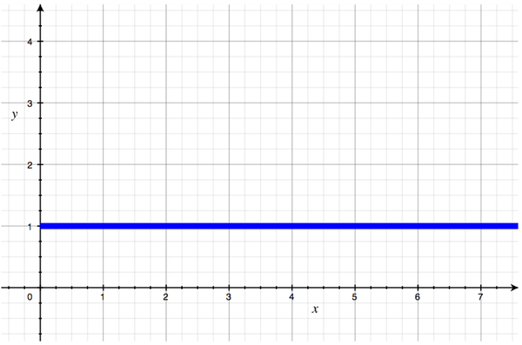
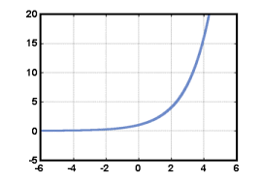
Log-Log Graphs
What are the best and worst case scenarios for Log-Log Graphs?
Best Case Scenario is a Perfectly Flat Graph
This means that the algorithm takes constant time, regardless of the size of the problem! Changes in X have lead to no changes in Y whatsoever. These are the most efficient types of algorithms/data structures.
Worst Case Scenario is an Exponential Graph
This means that the algorithm takes exponential time, and changes in of the size of the problem lead to drastic changes in the time taken! Even small increases in X lead to very large increases in Y. These are the least efficient types of algorithms/data structures.

Slide 12
Log-Log Graphs
What do parallel graphs mean?
If two straight lines are parallel on the log-log graphs, both have the same gradient.
This means, that as the size of the problem grows larger, time is increasing at the same rate on both graphs making them equally efficient!

Slide 13
Exercise
Using StackADT implement the stack operations using :
An Array Based Vector
A Singly Linked List
A Doubly Linked List
Benchmark how long these data structures take to push the following amounts of elements onto the stack:
100
1000
10000
To obtain an unbiased result it is best to carry out each set of push operations 10,000 times and then obtain an average result.
Plot the results on a Log-Log Graph, comment on the performance of each data structure for Pushing Elements onto a Stack.

Slide 14
Exercise
Continue on the previous Benchmarking Example and benchmark how long these data structures take to pop the following amounts of elements from the stack:
100
1000
10000
To obtain an unbiased result it is best to carry out each set of pop operations 10,000 times and then obtain an average result.
Plot the results on a Log-Log Graph, comment on the performance of each data structure for Popping Elements off a Stack.
Based on these, which data structure is best for a Stack?

Slide 15
Summary
Empirical analysis through benchmarks
Benchmarking and it’s weaknesses
Plotting benchmarks and log-log graphs
Benchmark visual inspection
Analysis of parallel lines in log-log graphs

Slide 16
End of lesson
Any questions?

